Slide 1

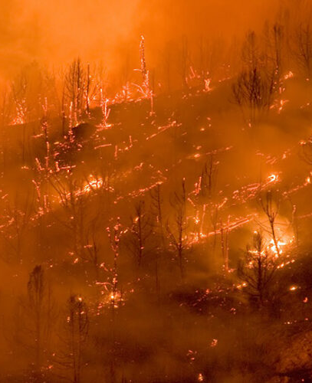

The impact of Wildfires on Tulare county

Slide 2
motivation
Predictive Health Planning: Forecasting smoke-related respiratory health trends informs proactive mitigation strategies.
Key Policy Informant: Smoke impact analysis aids city planning and healthcare resource allocation for Tulare County.
Community Health Impact: Rising hospitalizations and mortality demand preemptive measures and improved awareness.
Human-Centered Insights: Translating data into policies safeguards against smoke-induced respiratory risks for the community.

Slide 3

Research Questions
Smoke-related respiratory diseases vs. non-smoke-related diseases: Which is deadlier?
Relationship between fire smoke and age-standardized mortality for respiratory diseases?
Gender impact on mortality rate: Significant difference?
Are any age group people more susceptible?

Slide 4
Data Used
Dataset 1
Name: Mortalities from Respiratory Diseases in California Counties (1980-2014)
Smoke Pollution-Linked Diseases
Format: CSV (requires data cleaning)
Research Questions Addressable:
Mortality Rate Correlation
Gender Based Analysis
Source: Institute for Health Metrics and Evaluation (IHME)
Dataset 2
Source: California Health and Human Services Open Data Portal (CalHHS)
Name: Asthma Hospitalization Rates by County from 2015 to 2020
Format: CSV (requires data cleaning)
Research Questions Addressable:
Age-Based Impact Analysis

Slide 5
How is it human-centered?
People Centered
Participatory Design
Ethical
Viable

Slide 6
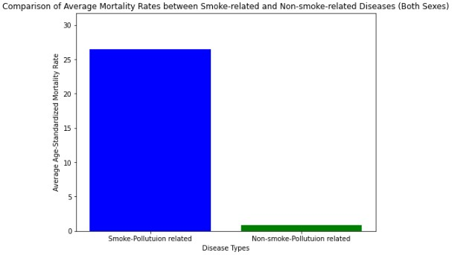
Mortality rates between Smoke vs non-smoke related diseases
6
Smoke-Related Diseases: Asthma, Chronic obstructive pulmonary disease (COPD)
Non-smoke-Related Diseases: Pneumoconiosis, Silicosis, Asbestosis etc.
Smoke-related diseases have ~30 times higher mortality rate compared to non-smoke related diseases

Slide 7
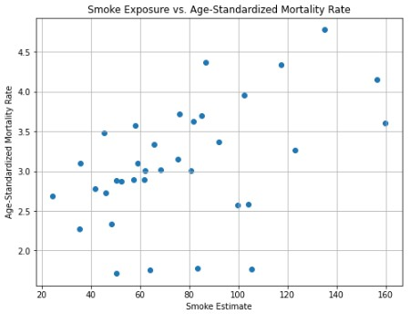
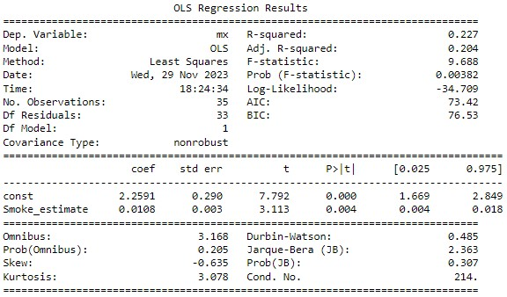
7
Asthma
Correlation Coefficient: 0.47639
A unit increase in fire smoke estimate, causes 0.0108-unit increase in age-standardized mortality rate
Statistically, there exists a relationship between fire smoke estimate and age-standardized mortality rate from Asthma

Slide 8
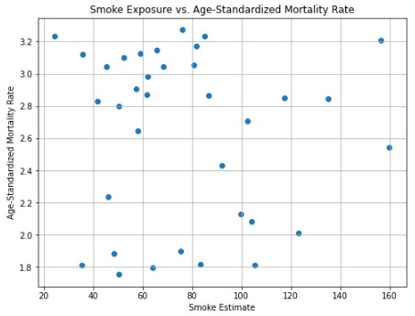
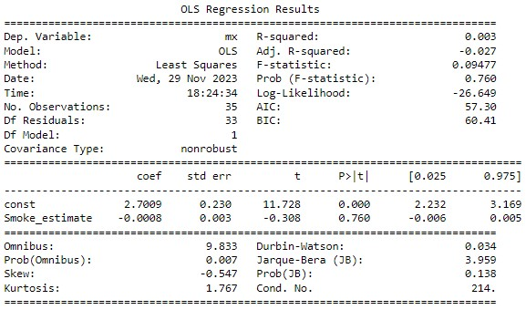
Chronic Obstructive Pulmonary Disease (COPD)
8​
Correlation Coefficient: -0.05351
A unit increase in fire smoke estimate, causes 0.0008-unit decrease in age-standardized mortality rate
Statistically, there exists NO relationship between fire smoke estimate and age-standardized mortality rate from COPD

Slide 9
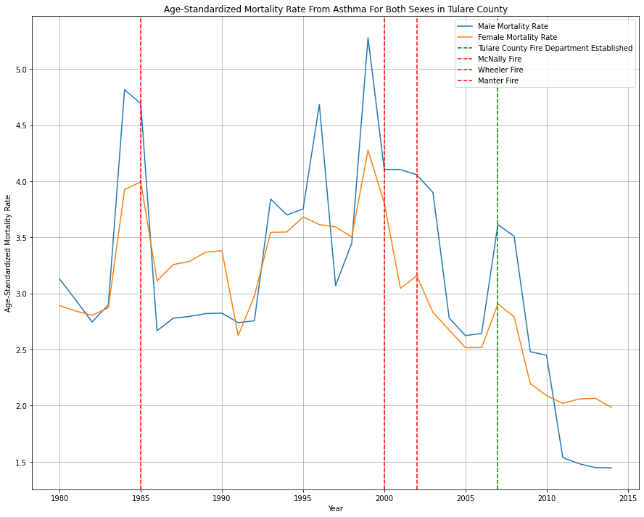
9​
GENDER-Based Analysis
T-Statistic: 0.715183, p-Value: 0.476944
Statistically, there is no significant difference in mortality rates between male and female population

Slide 10
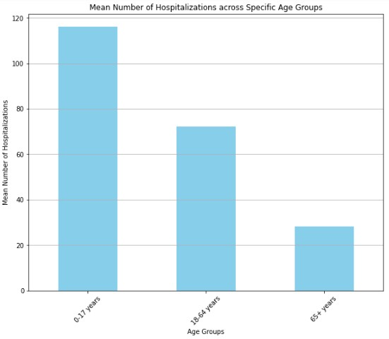
AGE-group analysis
10​
Number of Asthma-related hospitalizations across different age groups in Tulare County
Mean number of hospitalizations for 0-17 years is ~4 times compared to 65+ years
Age group 18-64 is ~2.5 times more susceptible compared to age group 65+ years

Slide 11
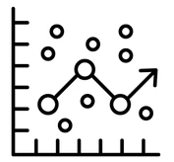
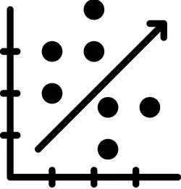

WHY DO THESE RESULTS MATTER?
Regression analysis helps guide targeted interventions against smoke-related health issues
Correlation analysis aids in policy creation for smoke-related disease reduction
Impacts legislation and health strategies, by accounting for age groups and gender-specific effects

